Slide 1
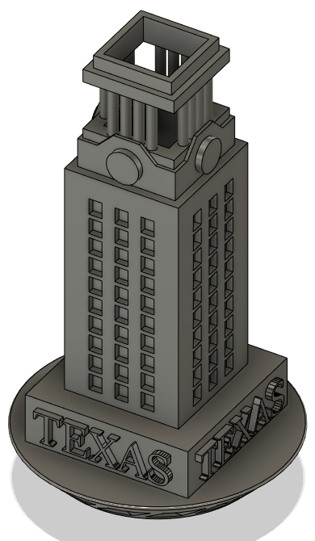
Wind-Powered Tops
Ryan Rhodes, Dahlia Lopez, Christopher Yoon, and Erick Jones

Slide 2
Agenda
Introduction
Market for Tops
Customer Needs
Design Specifications
Concept Generation
End Product
Testing
Conclusion

Slide 3
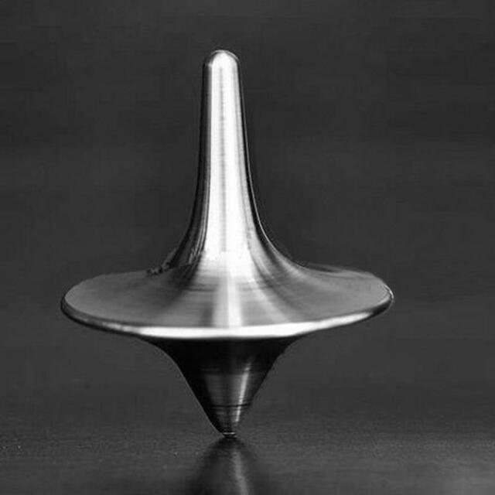
Introduction
Tops, one of the oldest archaeological toys, have a simple concept, twist and spin, yet they have had lasting power.
With SLS, we can create designs not possible with other methods
Our objective is to design a high quality collectible spinning top that is
Novel
Aesthetically pleasing
Durable
And most importantly spins well
“WHY A SPINNING TOP? THERE WILL BE SOMETHING IN IT FOR YOU FOREVER. - ForeverSpin

Slide 4
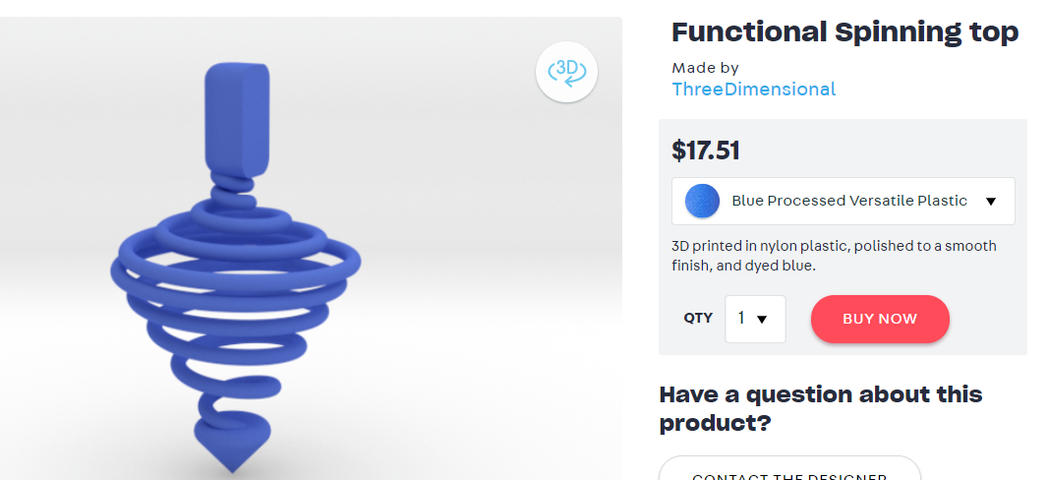
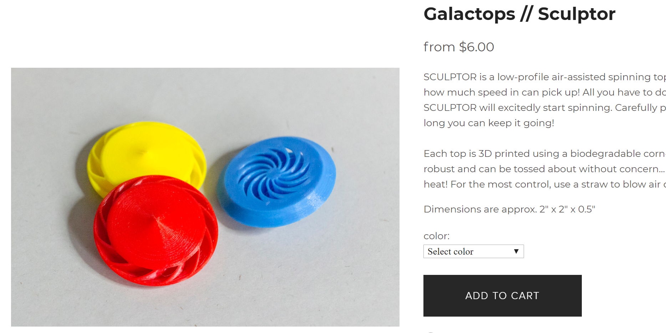
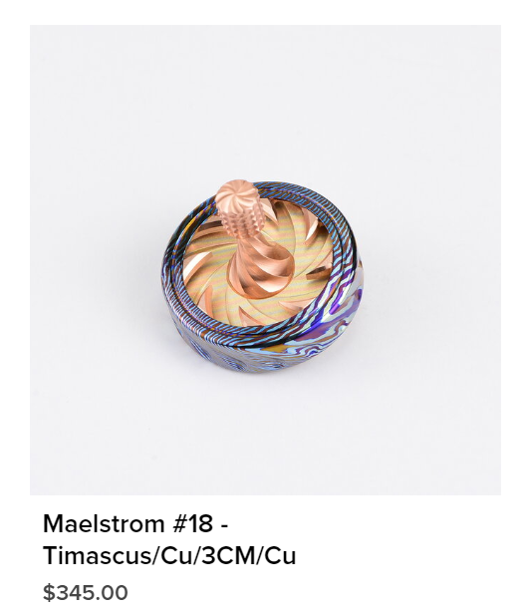
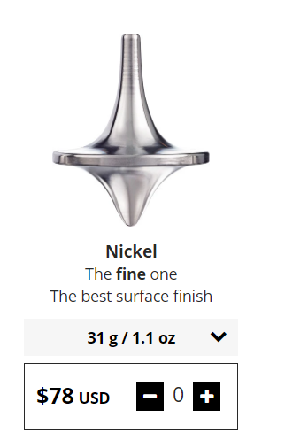
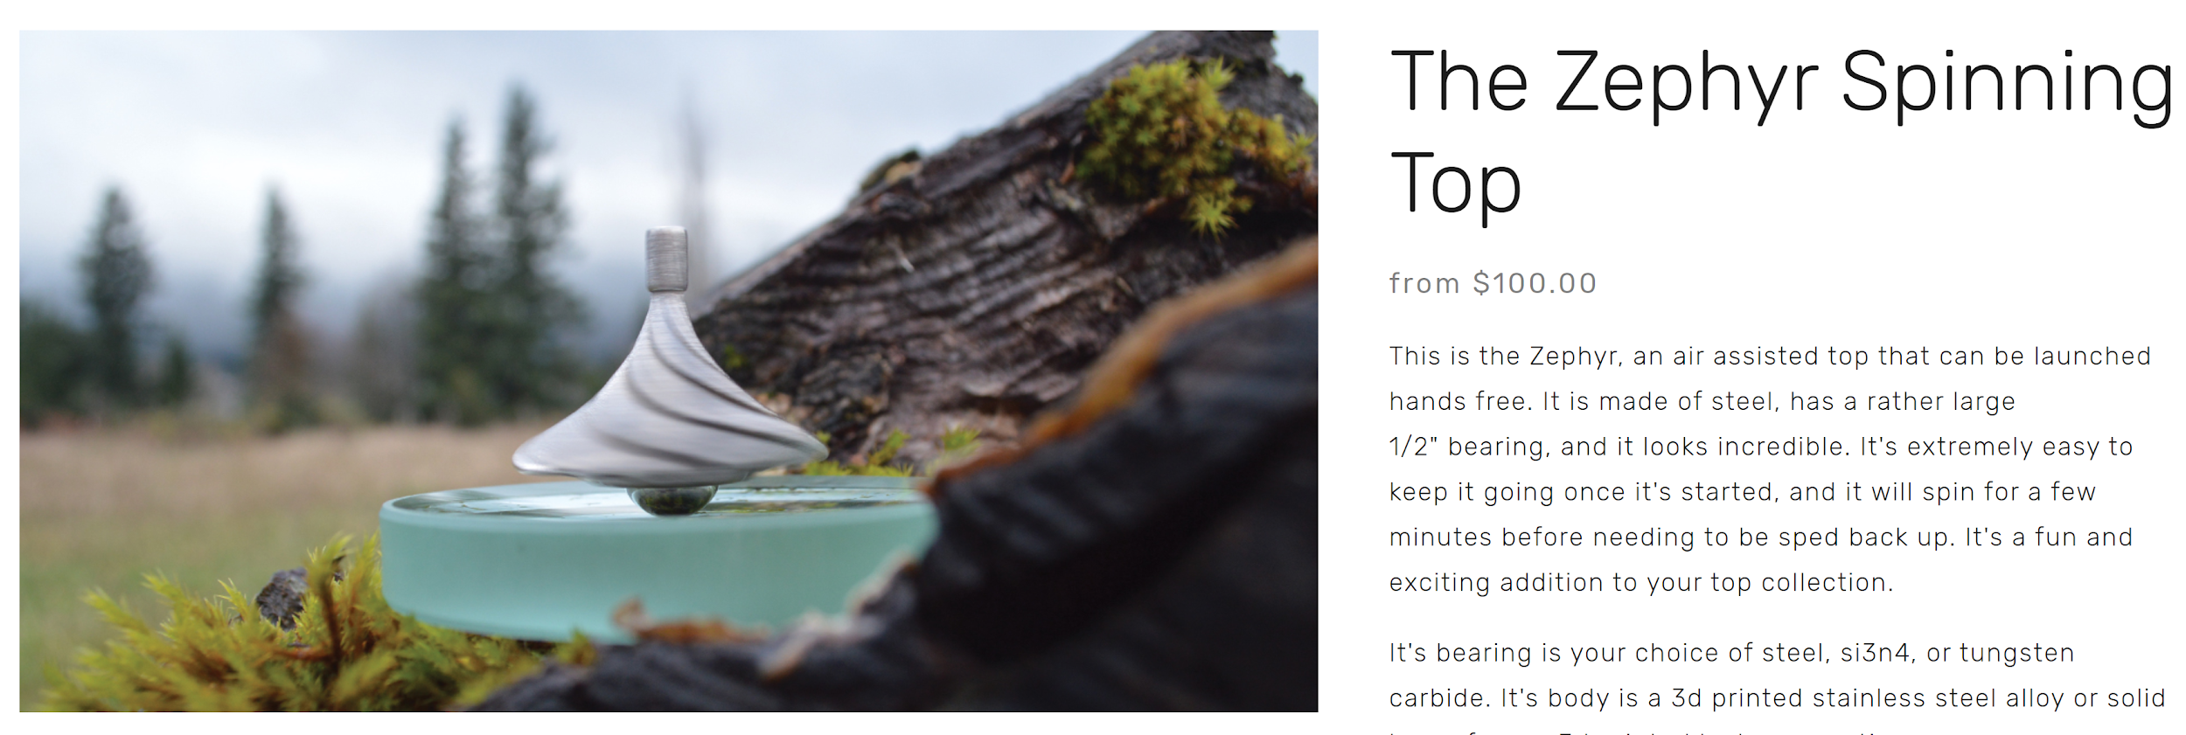
Market for High End Tops
Lower End:
High End:
Notes:
Low End: Talk about how the both can be made with a FDM printer
https://www.devinmontes.com/store/galactops-sculptor
High End: All Made from traditional manufacturing processes with quality metal and surface finish. The level of detail of the blades and mixes of metals drives up the costs.

Slide 5
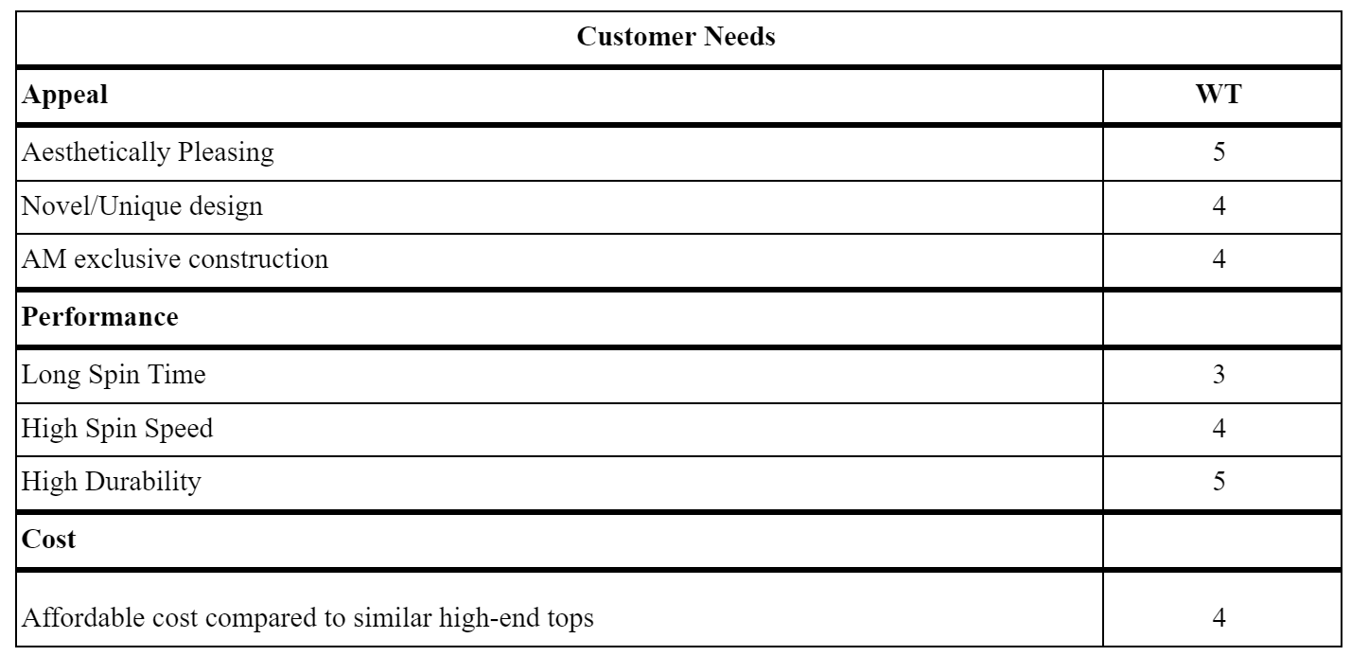
Customer Needs

Slide 6
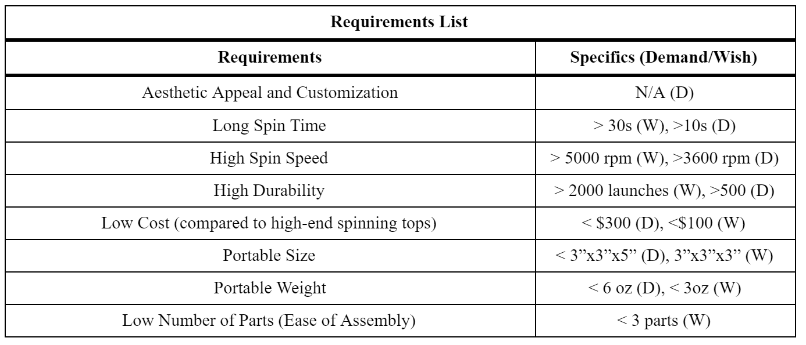
Design Specifications
Notes:
http://www2.eng.cam.ac.uk/~hemh1/gyroscopes/spinningtop.htm
The minimum spin speed (in revs per second) for a typical top to be stable is roughly equal to √g/a where g=9.81m/s² and a is the radius of the top. For our top with expected radius of 4-5cm, the minimum spin speed is around 62-78 rev/s, or 3600-4800 RPM.
-highlight more important onces

Slide 7
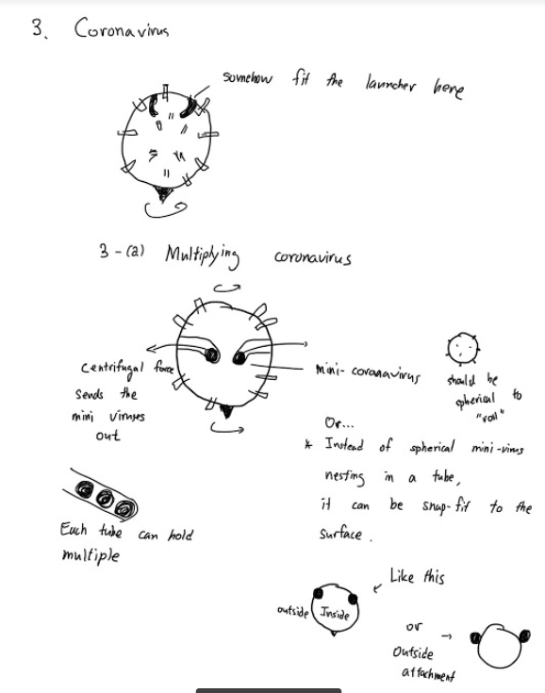
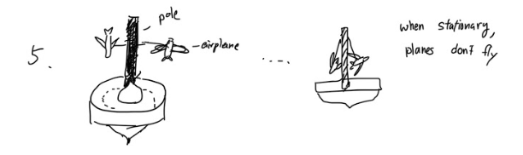
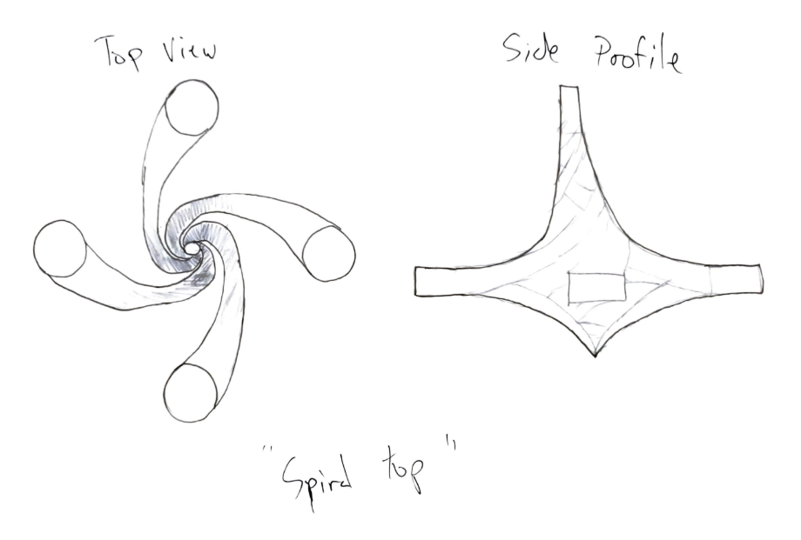
Concept Generation
Each member generate 2-3 designs
Notes:
Ryan
Each member come up with 2-3 designs that:
Unique and aesthetically pleasing
Functional
Benefit from being manufactured via AM SLS
Each member ranks top 5 designs and each rank is assigned a point value
Rank 1 = 5 points
Rank 2 = 4 points
Etc
Decided to combine top 2 designs

Slide 8
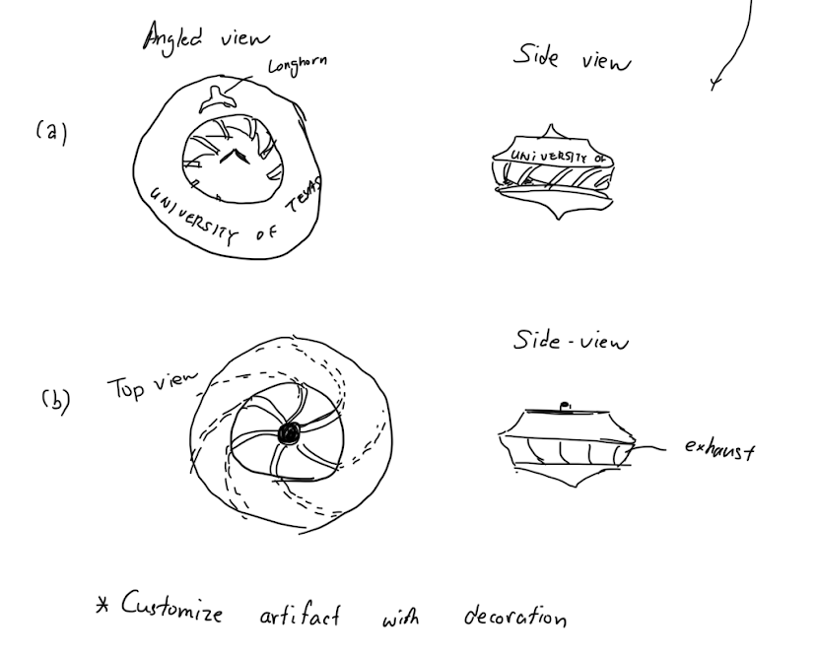
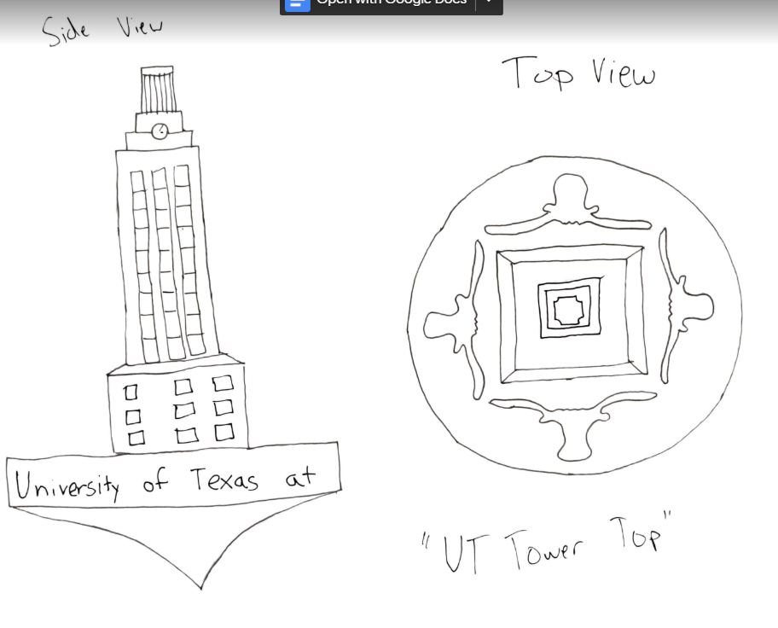
Concept Generation
Ranking point system
1st - 5th (1 being best)
1st place gets 5 points, 2nd gets 4, etc…
Top Choices
UT Tower
Wind Powered Top

Slide 9
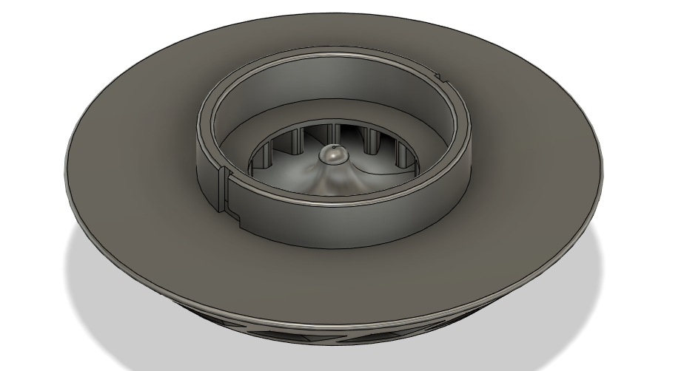
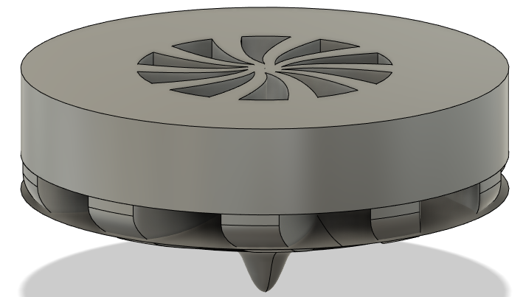
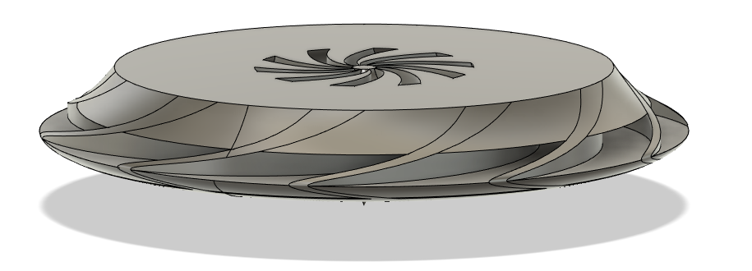
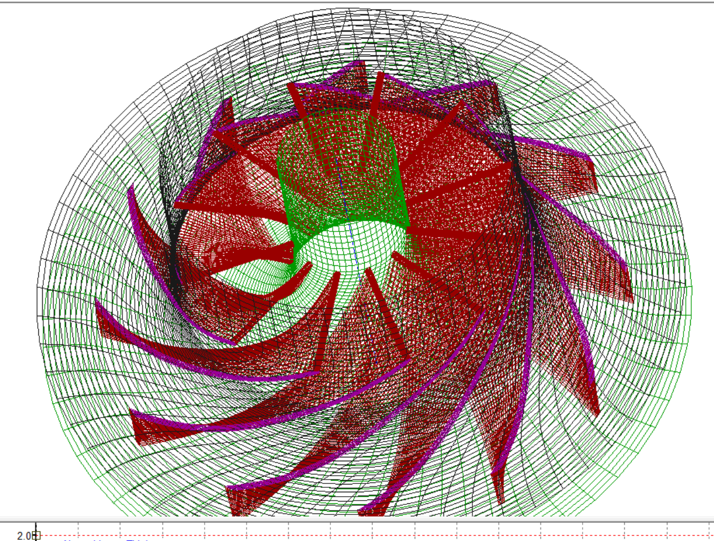
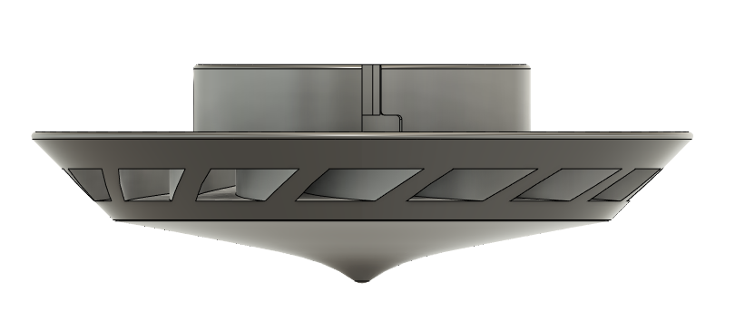
Design Process
Notes:
Ryan
Design iteration starts with just trying to produce geometry similar to turbine (top right)
Newer more defined model with a sleeker design (middle)
Analysis with impeller design software to give insight final design (far right)

Slide 10
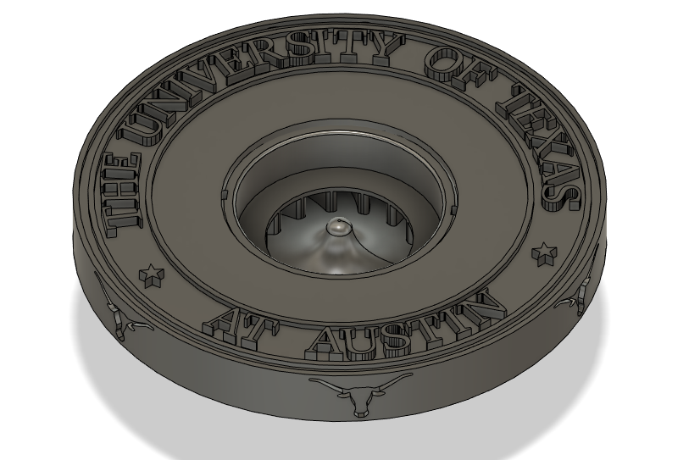
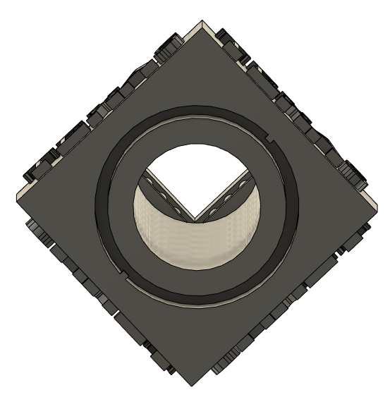
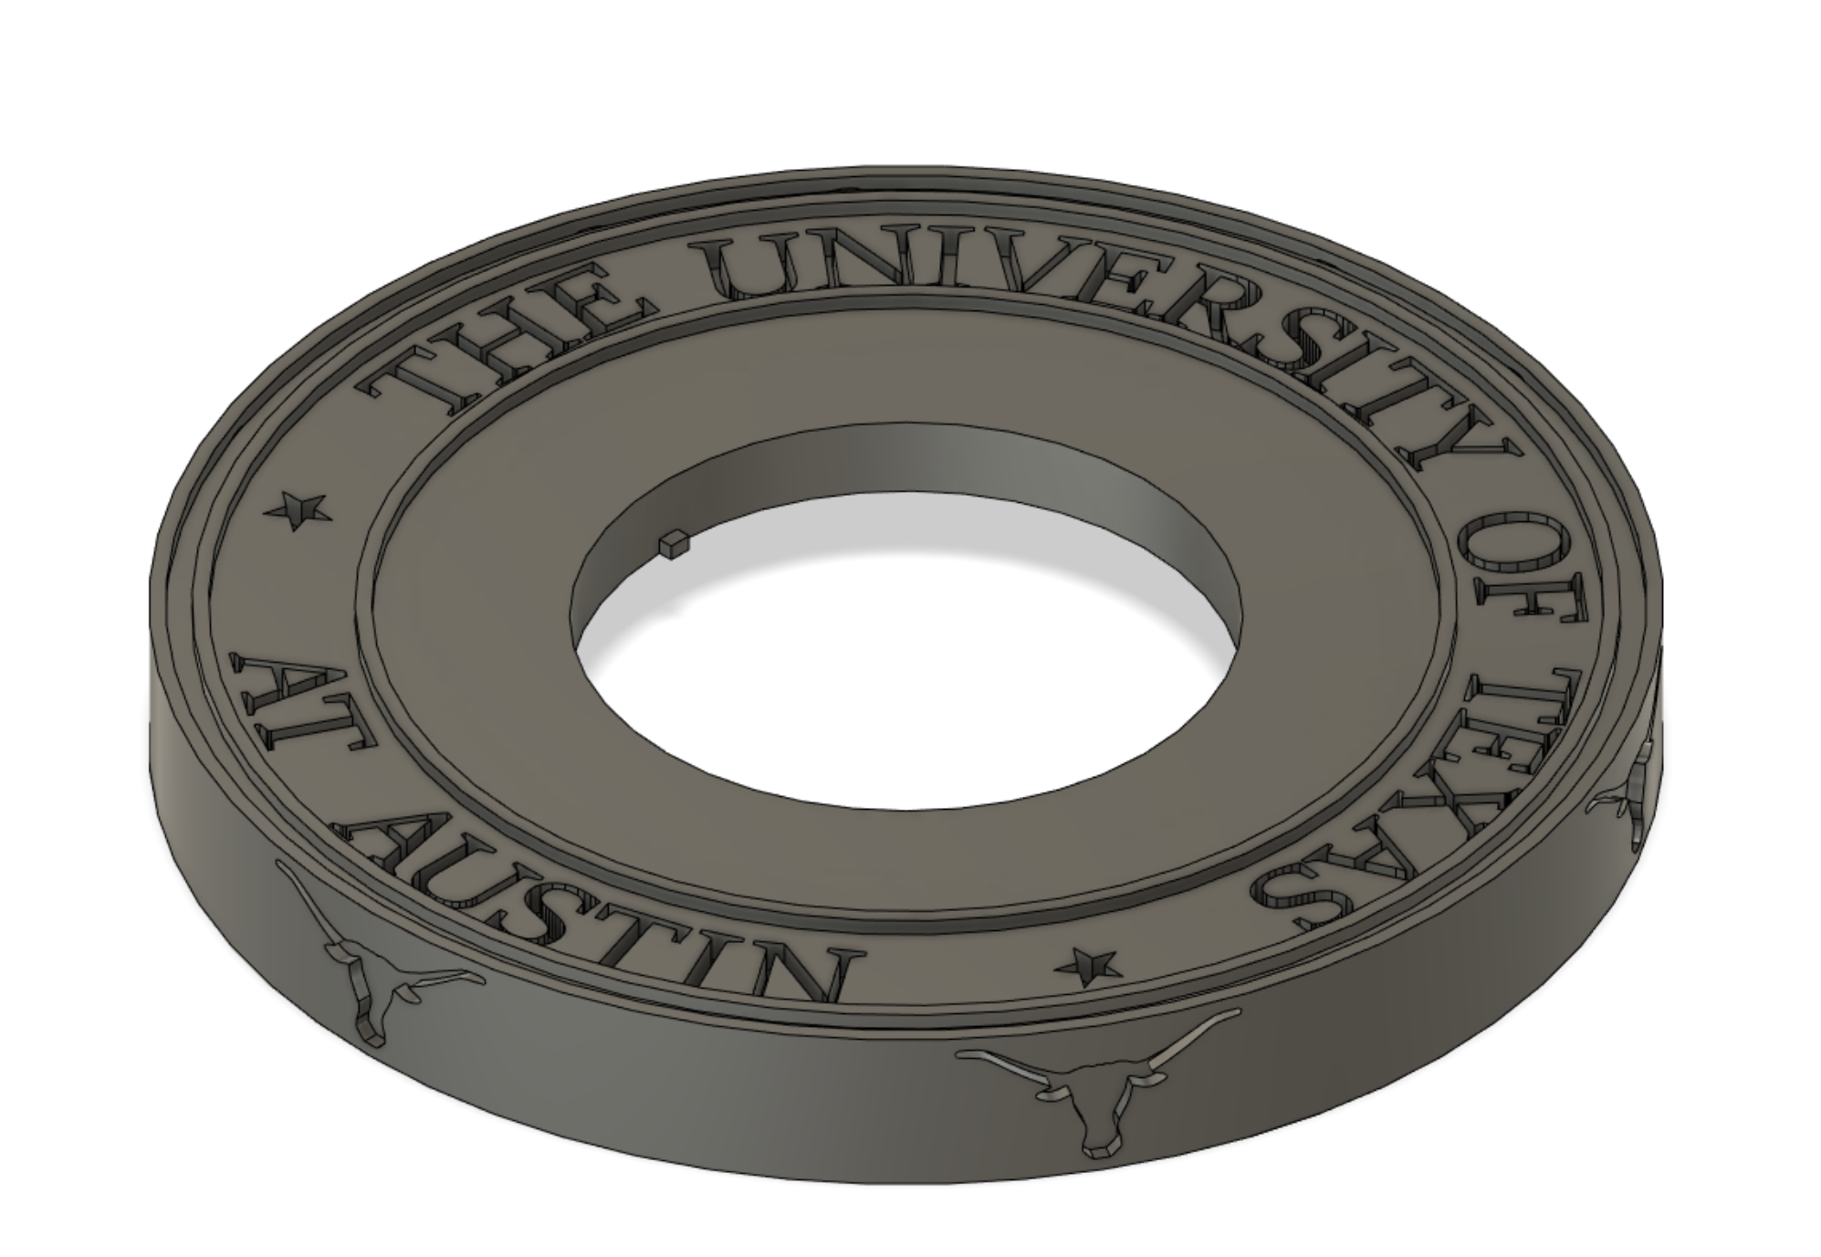
End Product
Notes:
Ryan
Tower assembly
Hole for air to flow through
Pins for connecting mechanism
Logo assembly
Modular design

Slide 11
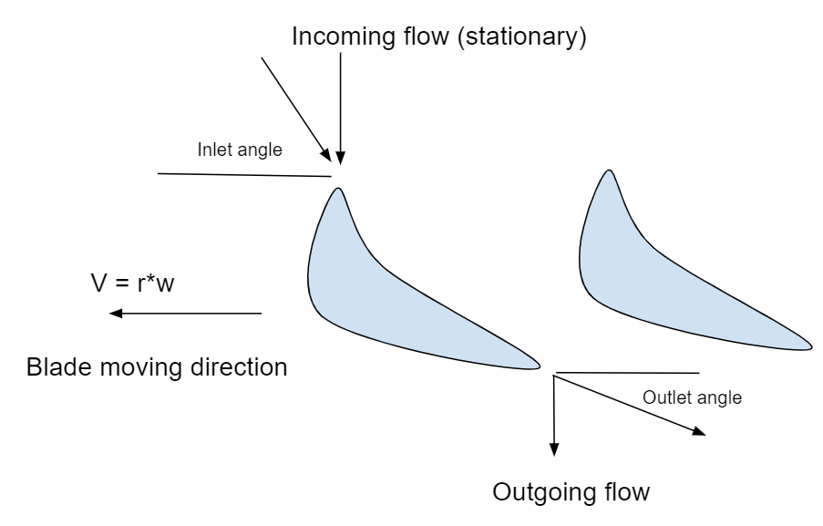
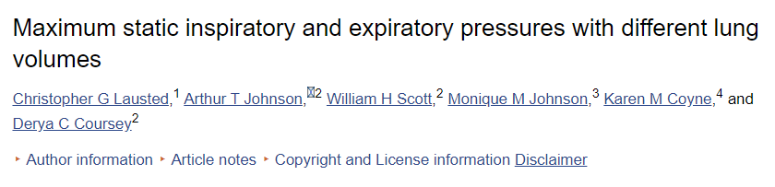
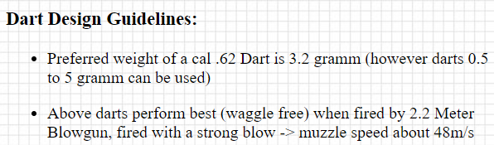
Part Evaluation - Aerodynamics
2-D analysis conducted to assess the aerodynamics of the blades
By drawing velocity triangles, we can get a minimum angle requirements for inlet and outlet of the blade.
Incoming flow speed was approximated as 35m/s, using data from a biomedical journal as well as aero-dart design guidelines.
Notes:
Chris
Finding appropriate inlet velocity is challenging. There are a lot of variables - male/female, lung volume, and more importantly, the measurement method (blowing to a tube/spirometer, blowing to blank space, etc.)
The numbers ranged from 10m/s - 50m/s. Considering that one of aero-dart design guideline had a target muzzle speed about 48m/s (probably for healthy male), we chose to be a little more conservative and went with 35m/s
The blades were about 2-3mm thick and 9mm high. Stress testing was deemed unnecessary, as the blades will be subjected to distributed pressure of air blown from humans.

Slide 12
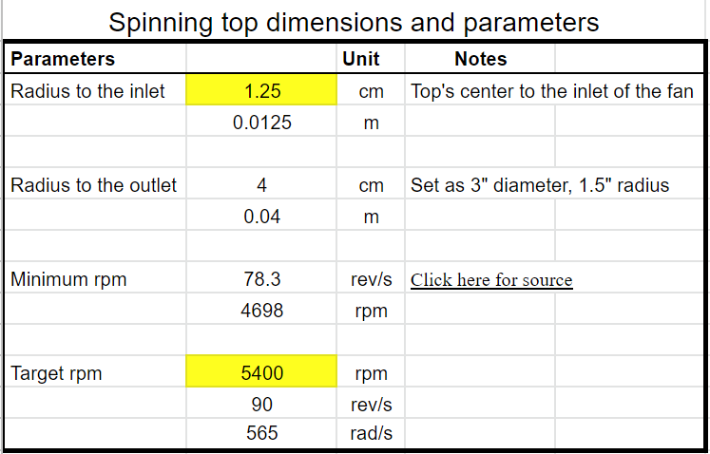
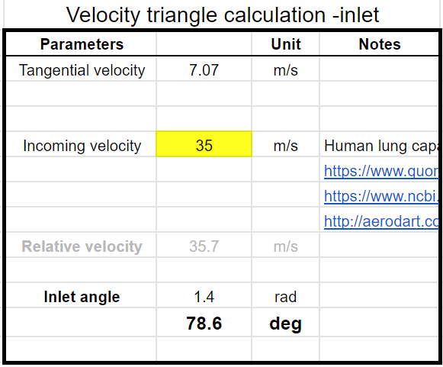
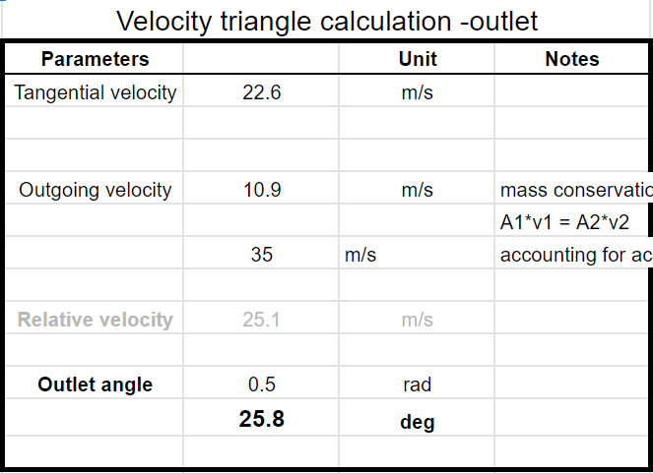
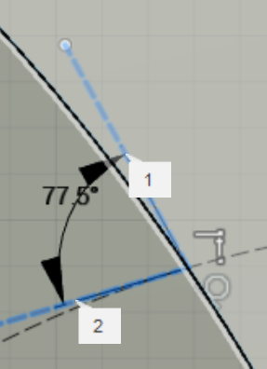
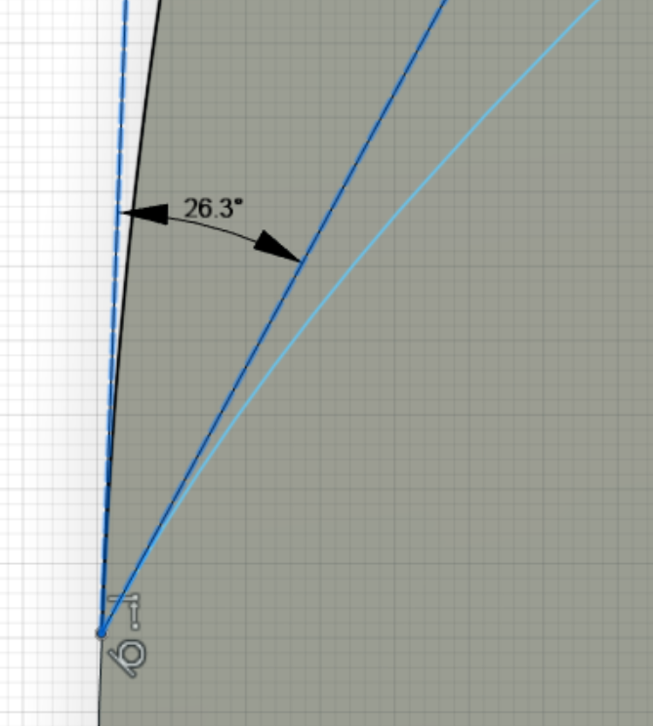
Part Evaluation - Continued
With target rpm of 5400, the blade needs inlet and outlet angles of 79 and 26 degrees
Designs were then modified in CAD, so that blades met the requirements

Slide 13
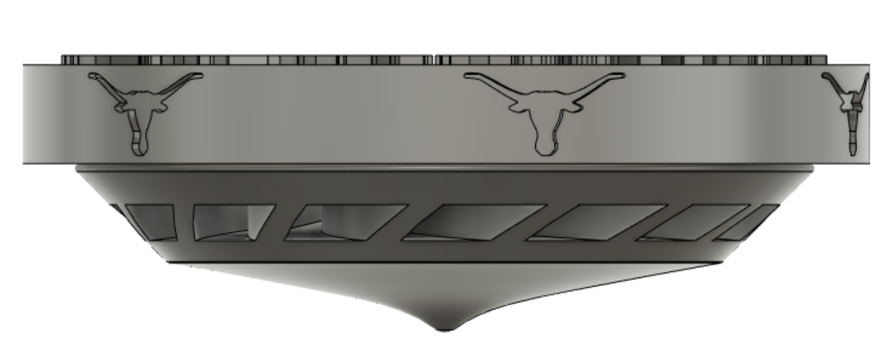
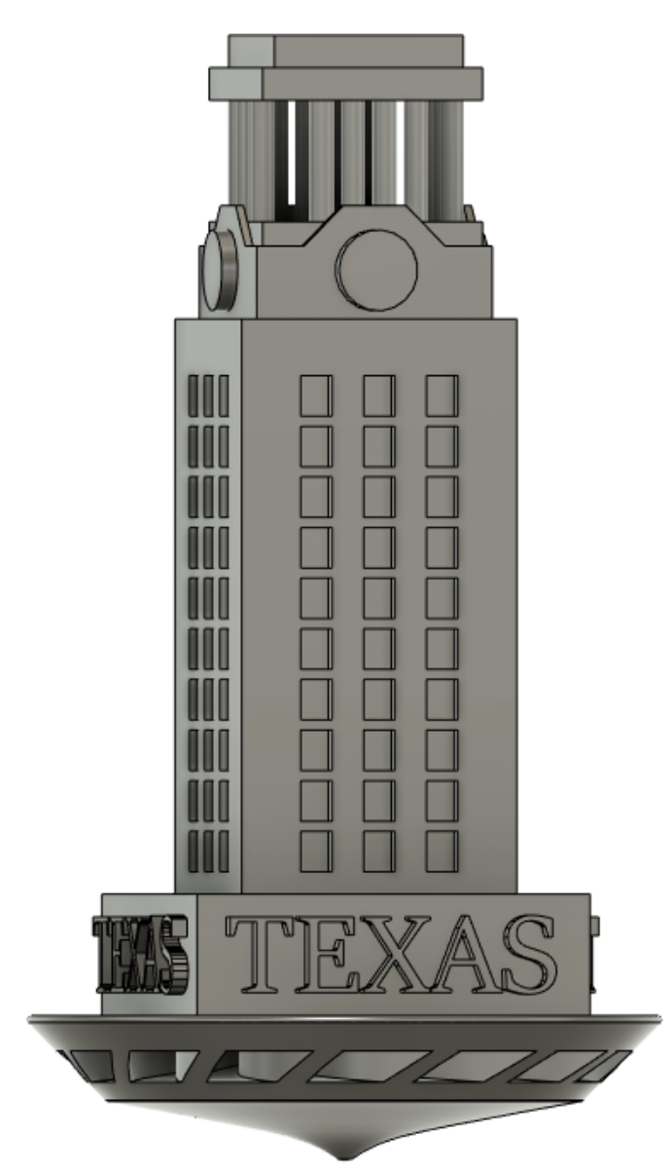
Manufacturing Cost Analysis
80mm
Nylon price: $45/kg for virgin powder
Powder density: 0.5g/cm^3
Build volume: 80mm x 80mm x 160mm = 1024 cm^3, (2% of build chamber volume)
We will be using around 512g of Nylon-12 powder
$11 if using 50% virgin powder. Even with operating costs (~$10 - $20), the two tops will cost $20-$30 to manufacture
28mm
3mm
129mm

Slide 14
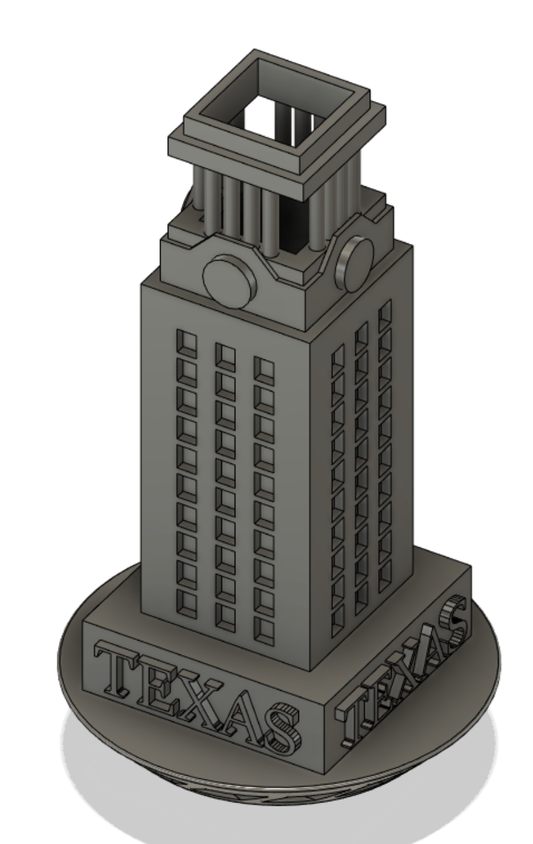
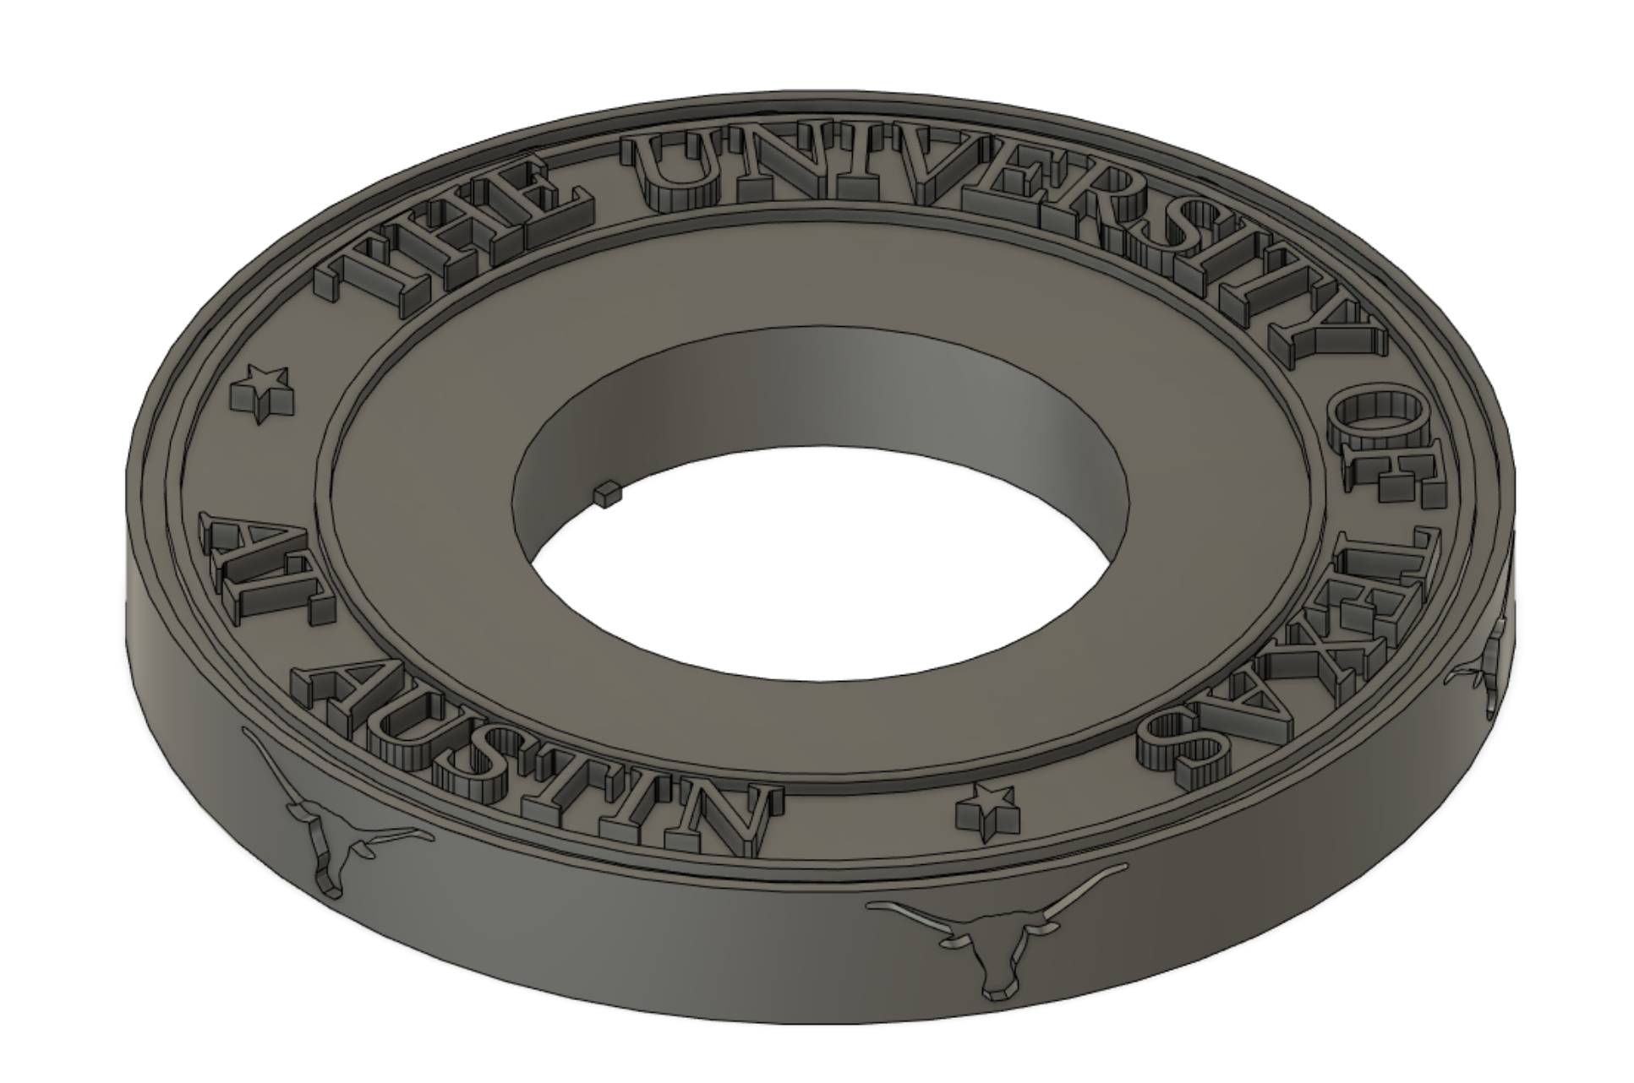
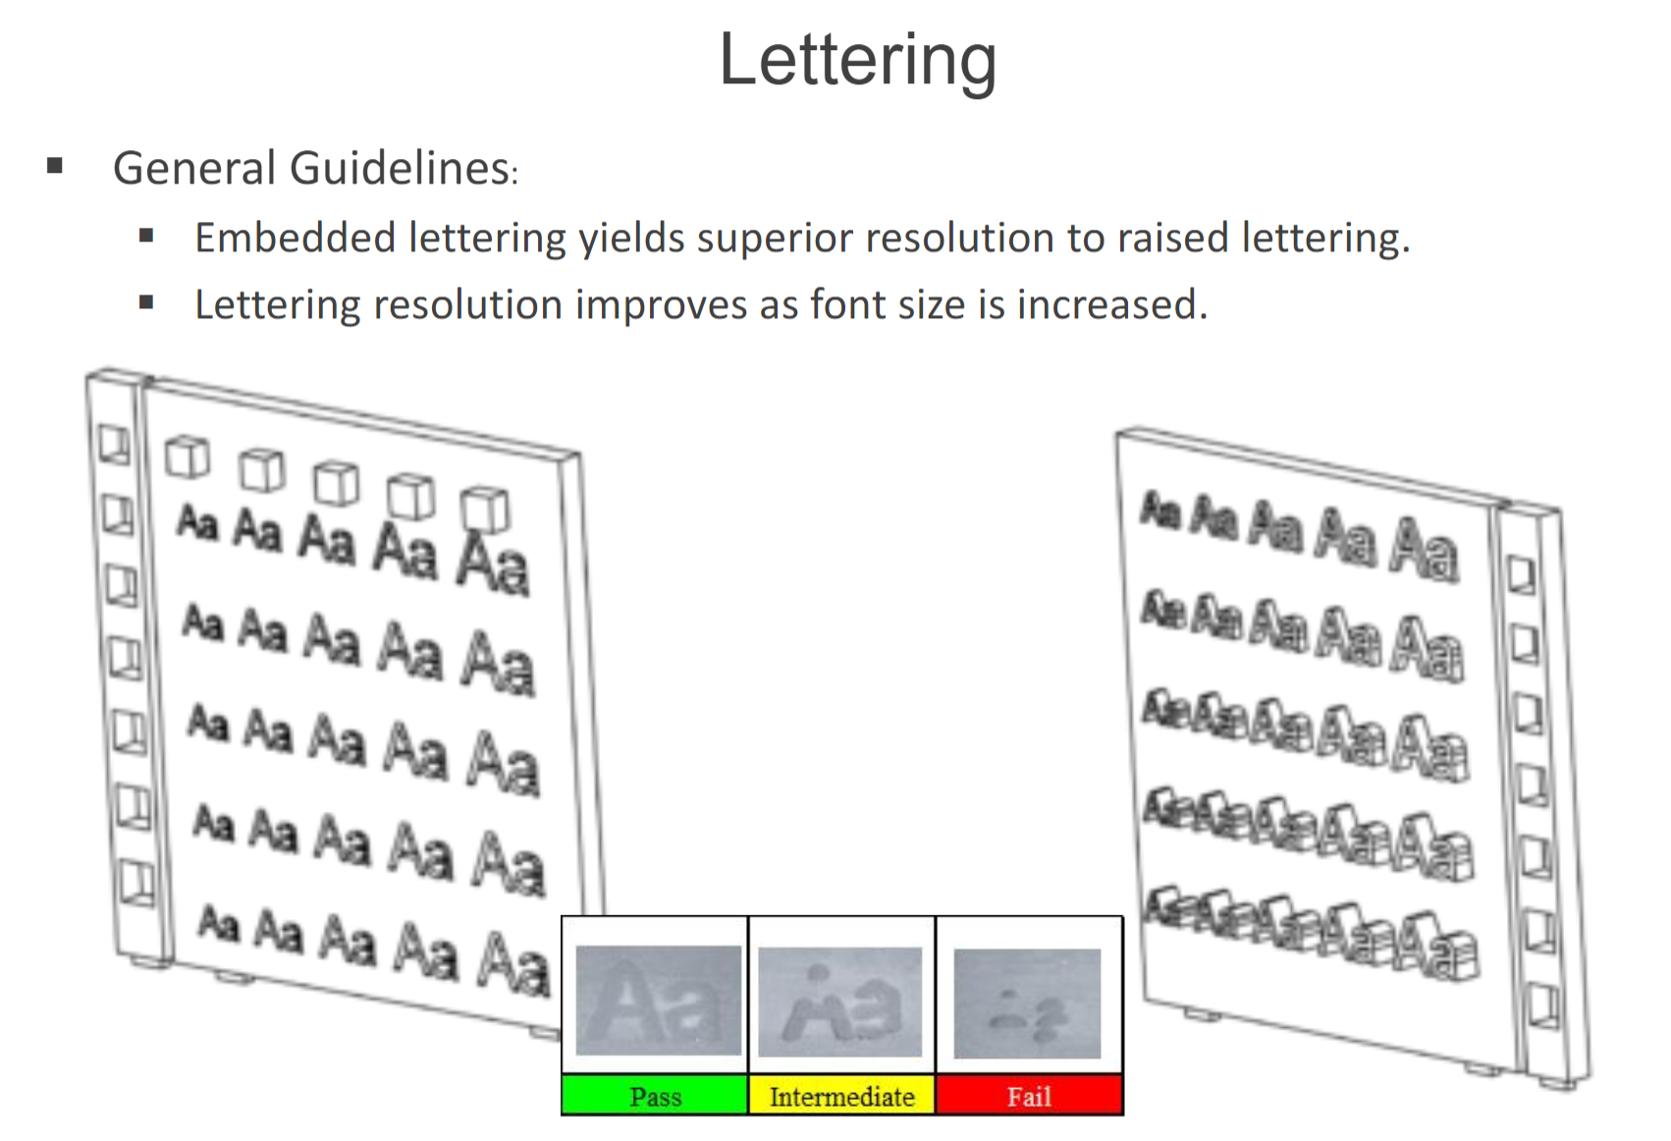
Customer Survey Results
1st
2nd
3rd
35 customer survey responses
1st: UT crest cap with embedded letters** (3.7 / 5)
2nd: UT tower (3.4 / 5)
3rd: UT crest cap with extruded letters (3.0 / 5)
**Embedded lettering is also more robust in SLS process

Slide 15
Conclusion
What did we learn?
Conflicting requirements (aesthetics vs functionality)
The square shape of the tower caused concerns in air resistance.
Since we had room to spare, we made the tower removable so that other tops can be installed (UT crest cap)
The new cap design is rated more aesthetically appealing, cheaper to manufacture, and more functional.
Future improvements:
Direct import of 3D blade design from impellers to improve efficiency
Adding colors

Slide 16
Questions?

